Slide 1
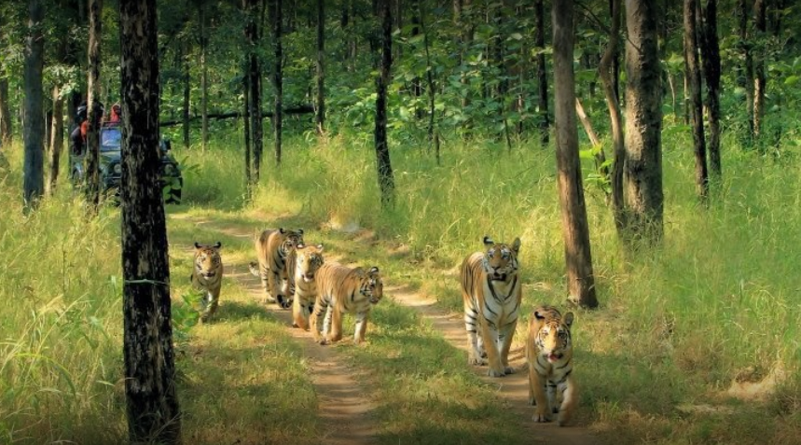
Time Series Analysis of Forest Cover
Dimple Umesh Kothari
MSc Data Analytics
Supervisor: Professor Eleni Vasilaki

Slide 2
Introduction
Purpose: This project aims to analyze forest cover trends in Pench National Park, Nagpur, from 2010 to 2023, using satellite imagery. Forest cover is the amount of trees that covers a particular area of land.
Problem: Forest cover has changed significantly due to climate change, land use, and natural disturbances. Understanding these changes is essential for effective management and conservation.
Solution: We will use LANDSAT-7 satellite imagery data focusing on January, February, March, October, November, and December. This analysis will help identify correlations between environmental factors and forest cover trends.

Slide 3
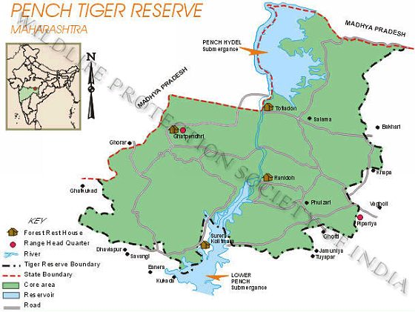
Study Area
The input imagery dataset is collected from standard online GIS satellite (LANDSAT-7) imaging data stores (USGS.gov).
The co-ordinates of the area are:
Latitude: 21.7630° N
Longitude:79.3391° E
Years: 2010 to 2023
Months: Jan, Feb, March, Oct, Nov, Dec
Source: https://www.wpsi-india.org/tiger/penchmh.php

Slide 4
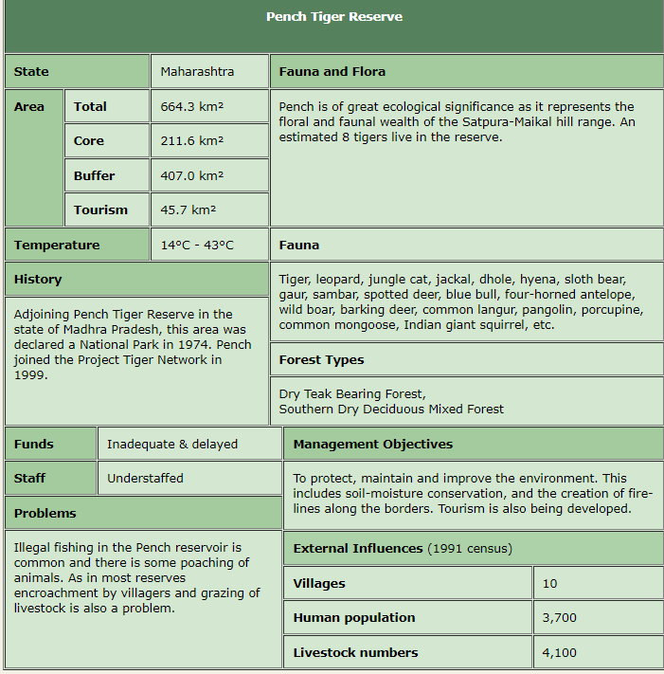
This selection is done based on the fact that the greenery is depicted in its true form in the months of pre-summers and winters, while in rainy seasons there are cloud covers, and in summers the trees shed their colours to sustain the heat.
Therefore, these 6 months were chosen for analysis of forest cover.
These images vary in dimensions and brightness hence data pre-processing is required.
Source: https://www.wpsi-india.org/tiger/penchmh.php

Slide 5
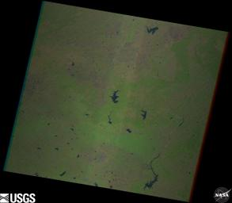
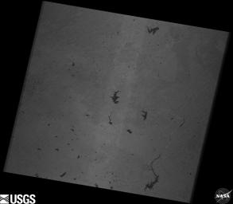
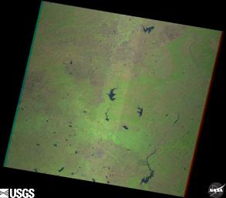
1. Brovey Transform (November 2019)
Methodology
The Brovey transform is a technique used in remote sensing to enhance spatial resolution by fusing low-resolution multispectral images with a high-resolution panchromatic image, to preserve spectral information while sharpening the image.
Multi-Spectral Image
Panchromatic Image
Fused Image

Slide 6
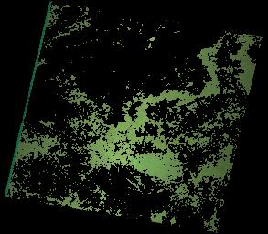
2. Segmentation – Ratio Based Thresholding
Ratio-based thresholding segmentation is a technique used in image processing to separate objects from the background by comparing the intensity of pixels in an image.
In the below image, it separates the green vegetation area from the red and blue bands.
Fused Image
Segmented Image

Slide 7
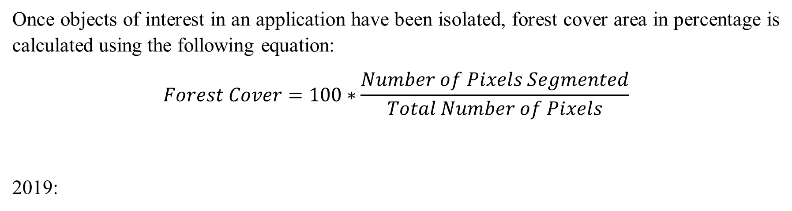
3. Calculating Forest Cover
Once objects of interest in an application have been isolated, forest cover area in percentage is calculated using the following equation:
$$Forest Cover=100∗\frac{Number of Pixels Segmented}{Total Number of Pixels}$$
2019:
Forest Cover | Timestamp
4.4909 | 201901
8.9870 | 201902
2.4753 | 201903
45.888 | 201904
19.186 | 201905
8.6644 | 201906

Slide 8
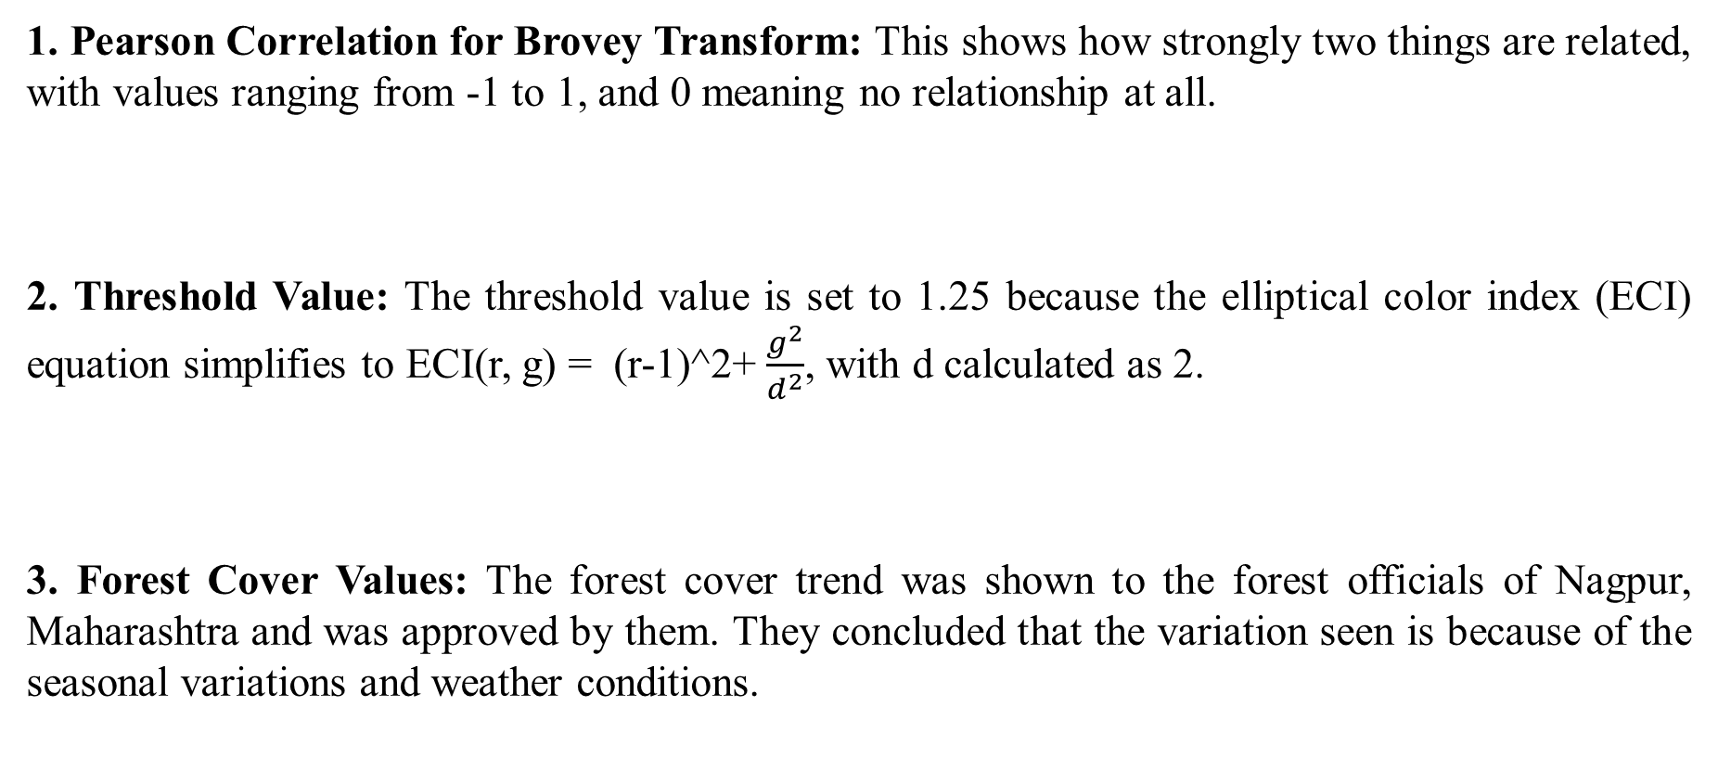
4. Evaluation
1. Pearson Correlation for Brovey Transform: This shows how strongly two things are related, with values ranging from -1 to 1, and 0 meaning no relationship at all.
2. Threshold Value: The threshold value is set to 1.25 because the elliptical color index (ECI) equation simplifies to ECI(r, g) = (r-1)^2+ $\frac{g^{2}}{d^{2}}$, with d calculated as 2.
3. Forest Cover Values: The forest cover trend was shown to the forest officials of Nagpur, Maharashtra and was approved by them. They concluded that the variation seen is because of the seasonal variations and weather conditions.
November 2019 | 0.7680
Threshold | 1.25

Slide 9
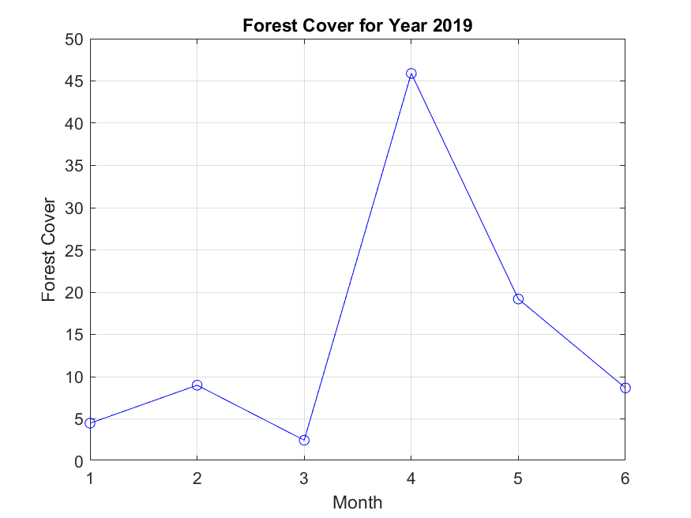
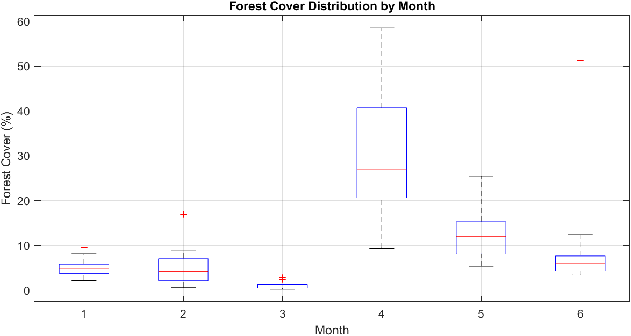
Results
Pench National Park is a Tropical deciduous forest. These alternate between lush growth in the wet season and dry, leafless conditions in the dry season, with most trees shedding leaves to conserve water. Some trees with groundwater access remain evergreen, and these seasonal changes impact the entire ecosystem.

Slide 10
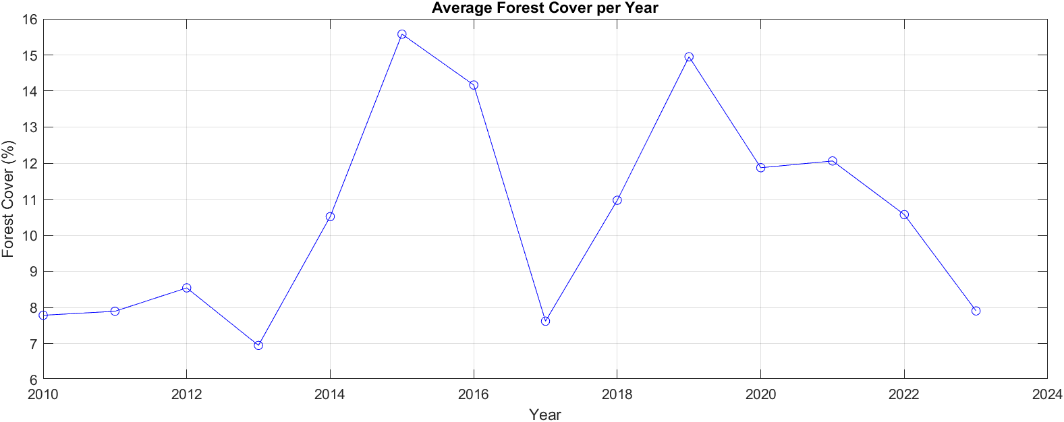
Results
Between 2014 and 2019, Maharashtra's forest cover increased from approximately 50,650 sq kms to about 50,778 sq kms, as reported by the Indian State of Forest Report**. This growth was driven by extensive afforestation programs, agroforestry, and effective conservation efforts.
Enhanced protection of existing forests and advancements in satellite monitoring also contributed to more accurate reporting. Overall, government policies promoting sustainable land use and tree planting played a crucial role in this positive trend.

Slide 11
Conclusion
The analysis of forest cover in Pench National Park from 2010 to 2023 reveals significant changes driven by climate change, land use, and seasonal variations.
Using satellite imagery techniques such as the Brovey Transform and ratio-based thresholding, the study identified changes in vegetation cover and correlated these changes with environmental factors.
Most variations in forest cover are due to natural seasonal changes, with lush growth occurring in the wet season and reduced foliage in the dry season.
Additionally, from 2014 to 2019, Maharashtra's overall forest cover increased, driven by afforestation programs, conservation efforts, and sustainable land use policies.
Effective management is essential to maintain and enhance forest cover in the face of these changes.

Slide 12
Conclusion
How the forest cover trends might shape future policies-
Climate Change Adaptation:
Flexible Policies
Climate-Resilient Strategies
Evidence-Based Policy Adjustments:
Expand Successful Programs
Targeted Interventions
Sustainable Land Use:
Balance Development and Conservation
Incentivize Sustainability
Long-Term Strategic Planning:
Set Ambitious Goals
Adaptive Management
Technological Integration:
Advanced Monitoring
Transparency

Slide 13
Thank you!!!

